Slide 1

Google Play Store Apps Analysis
Luthfi Nassir
12223424
Roll no. 33

Slide 2
Introduction
- Purpose: Explore trends in Google Play Store apps
- Tools: Tableau for visualization, Tableau Prep for data cleaning
- Dataset: 1,000,000+ rows, 13 columns with attributes like installs, category, rating, size, and price

Slide 3
Graphs and Analysis Overview
- Top Categories by Number of Apps (Bar Chart)
- Installation Across Categories (Treemap)
- Distribution of Apps by Rating (Bar Chart)
- Maximum Price in Each Category (Bar Chart)
- Revenue by Category (Bubble Chart)

Slide 4
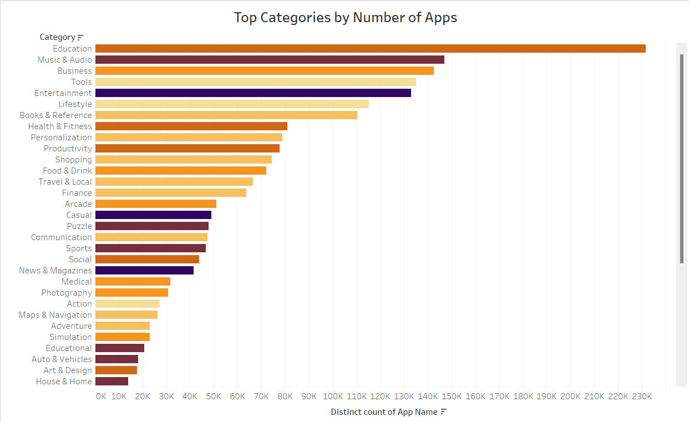
Top Categories by Number of Apps
Graph Type: Bar Chart
Insights: Categories like Education, and Business dominate the store, reflecting developer focus.

Slide 5
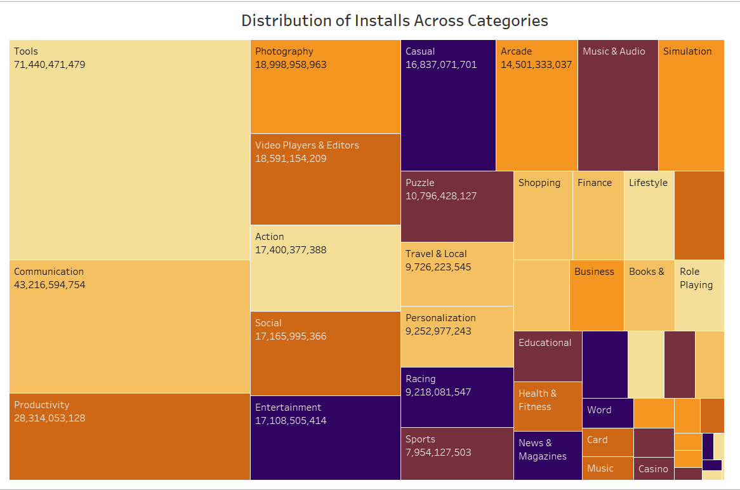
Installation Across Categories
Graph Type: Treemap
Insights: Communication and Social categories have the highest installs, highlighting popular app types.

Slide 6
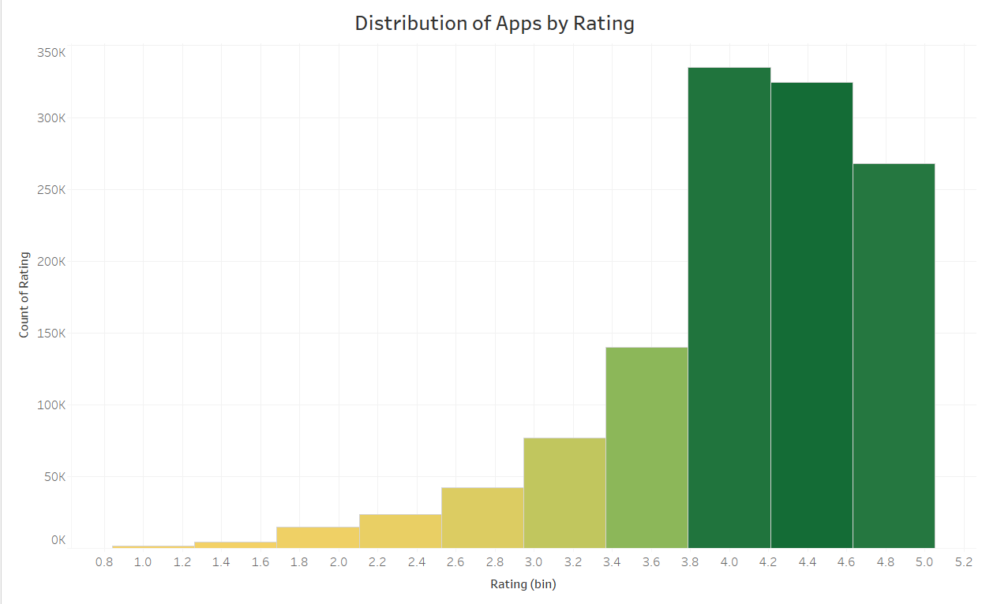
Distribution of Apps by Rating
Graph Type: Bar Chart
Insights: Most apps have ratings between 4.0 and 4.5, indicating high user satisfaction.

Slide 7
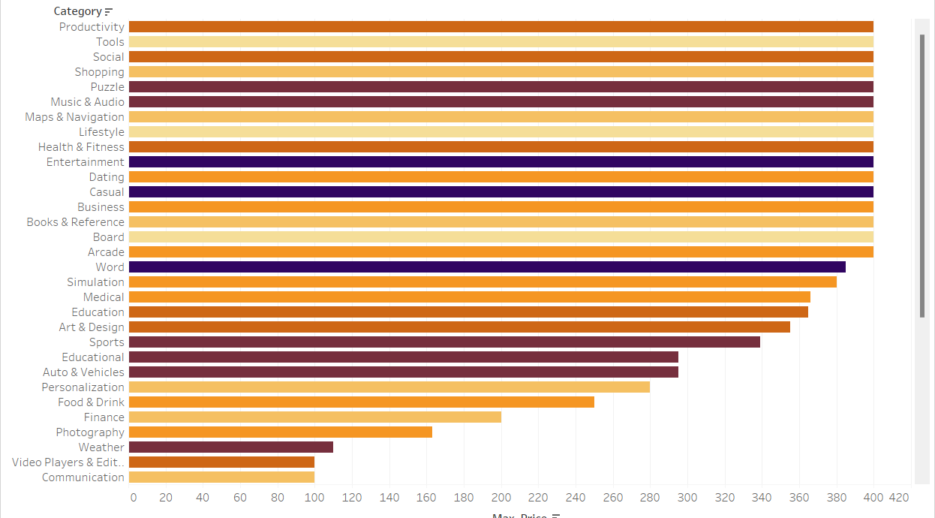
Maximum Price in Each Category
Graph Type: Bar Chart
Insights: Niche categories like Tools, Education etc. have the highest-priced apps.

Slide 8
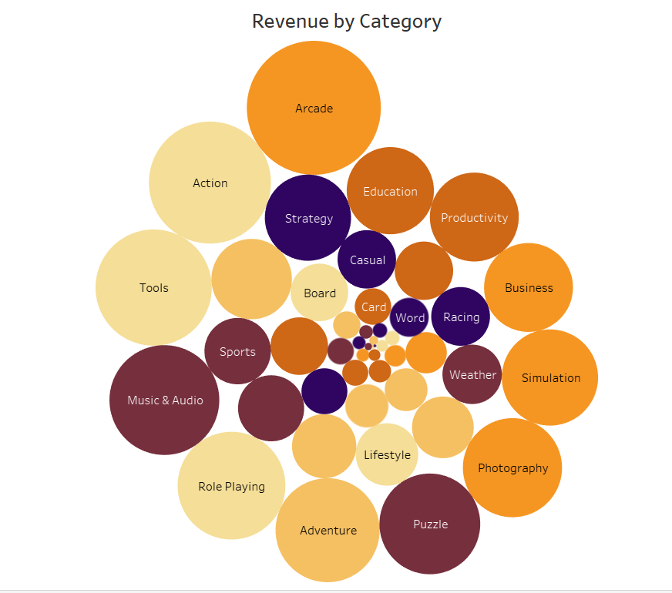
Revenue by Category
Graph Type: Bubble Chart
Insights: Categories such as Games and Productivity generate the most revenue, highlighting monetization success.

Slide 9
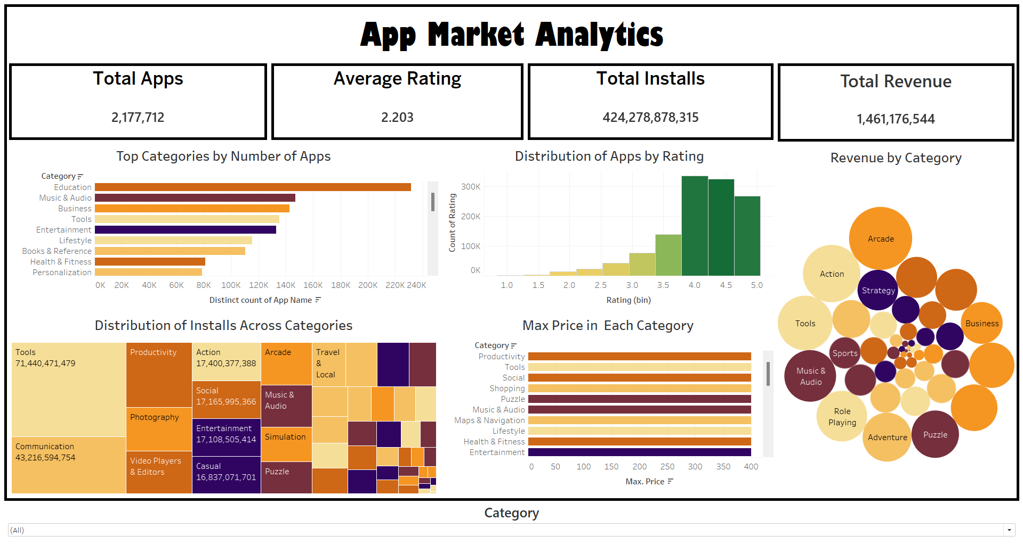
Dashboard

Slide 10
Conclusion
- Diverse categories cater to a wide range of users.
- Popularity and revenue generation vary by category.
- Dashboard provides actionable insights for developers and marketers.

Slide 11

Thank You!

